Slide 1
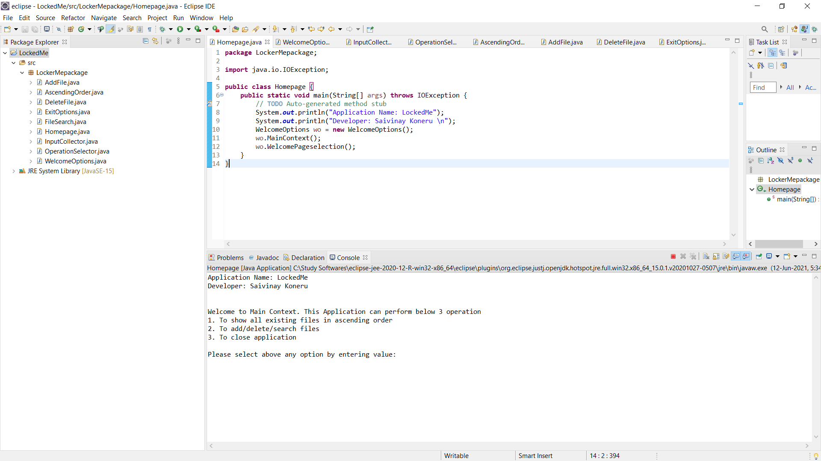
Home Page display
https://github.com/Saivinay08/Phase-1-LockedMeProject

Slide 2
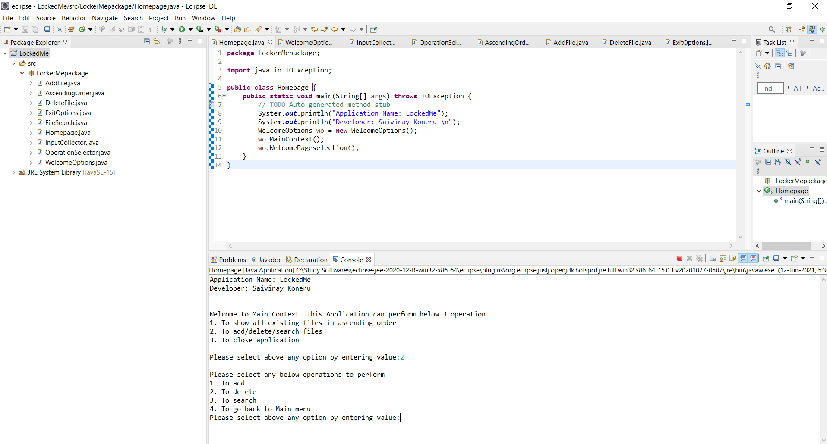
Option 2: for add/delete/search operations

Slide 3
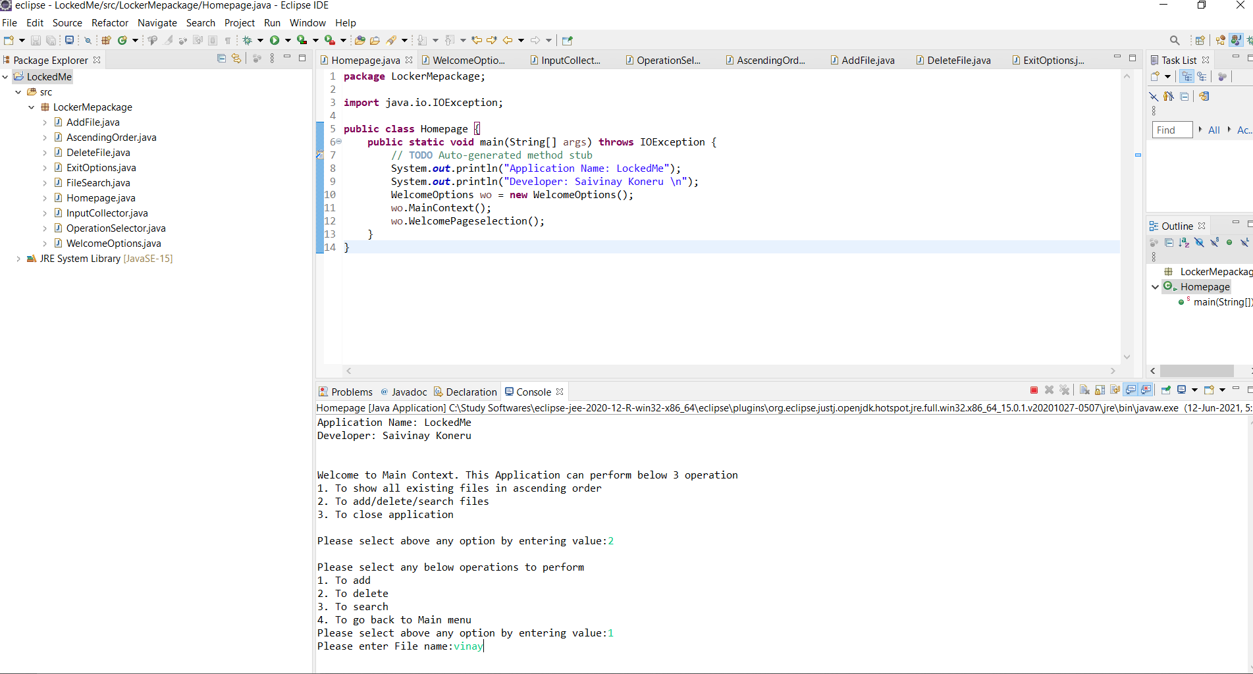
By entering option 1,Application asked to add file name & entered

Slide 4
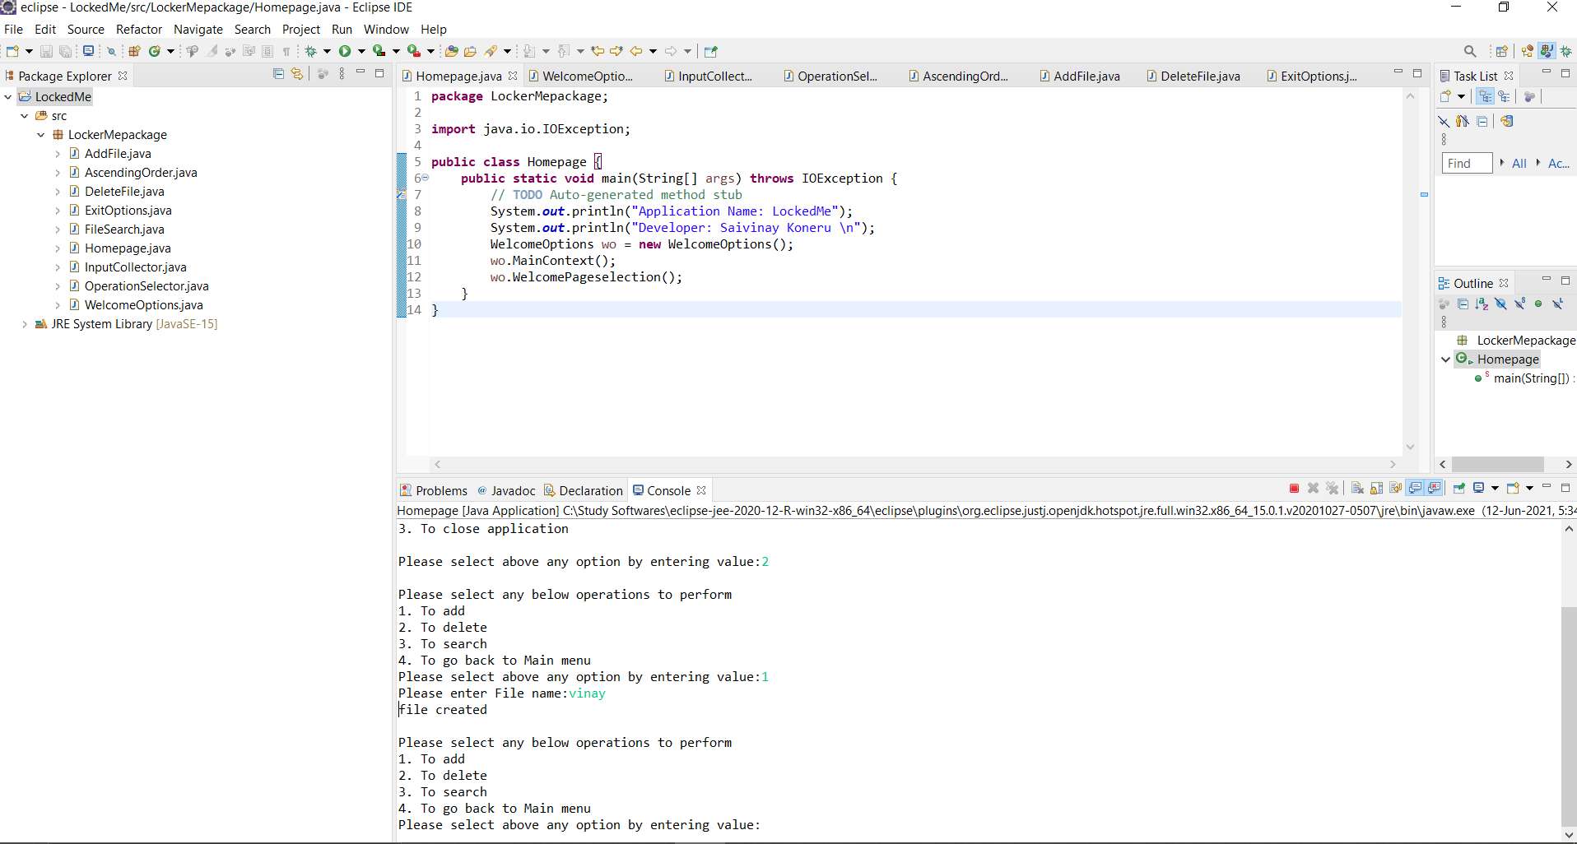
Showed display as file created & lets add 3 more file to perform remaining operations

Slide 5
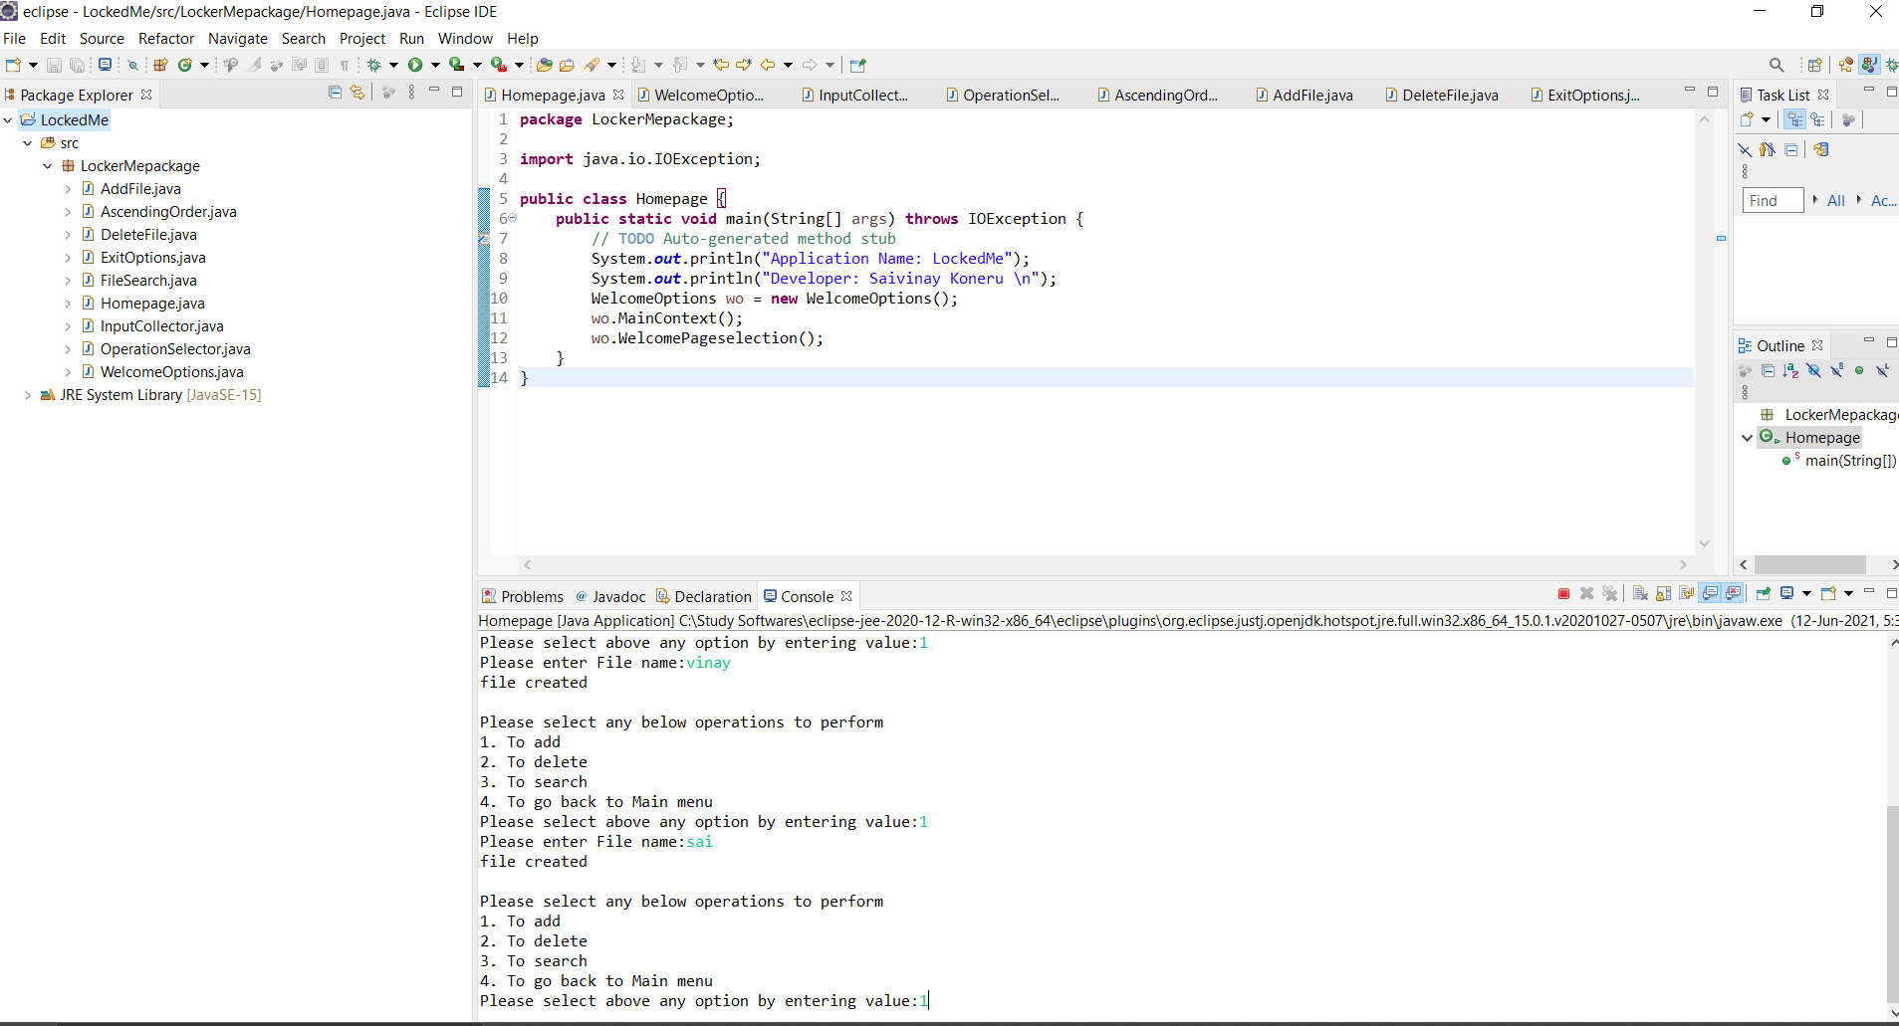
Adding few more files

Slide 6
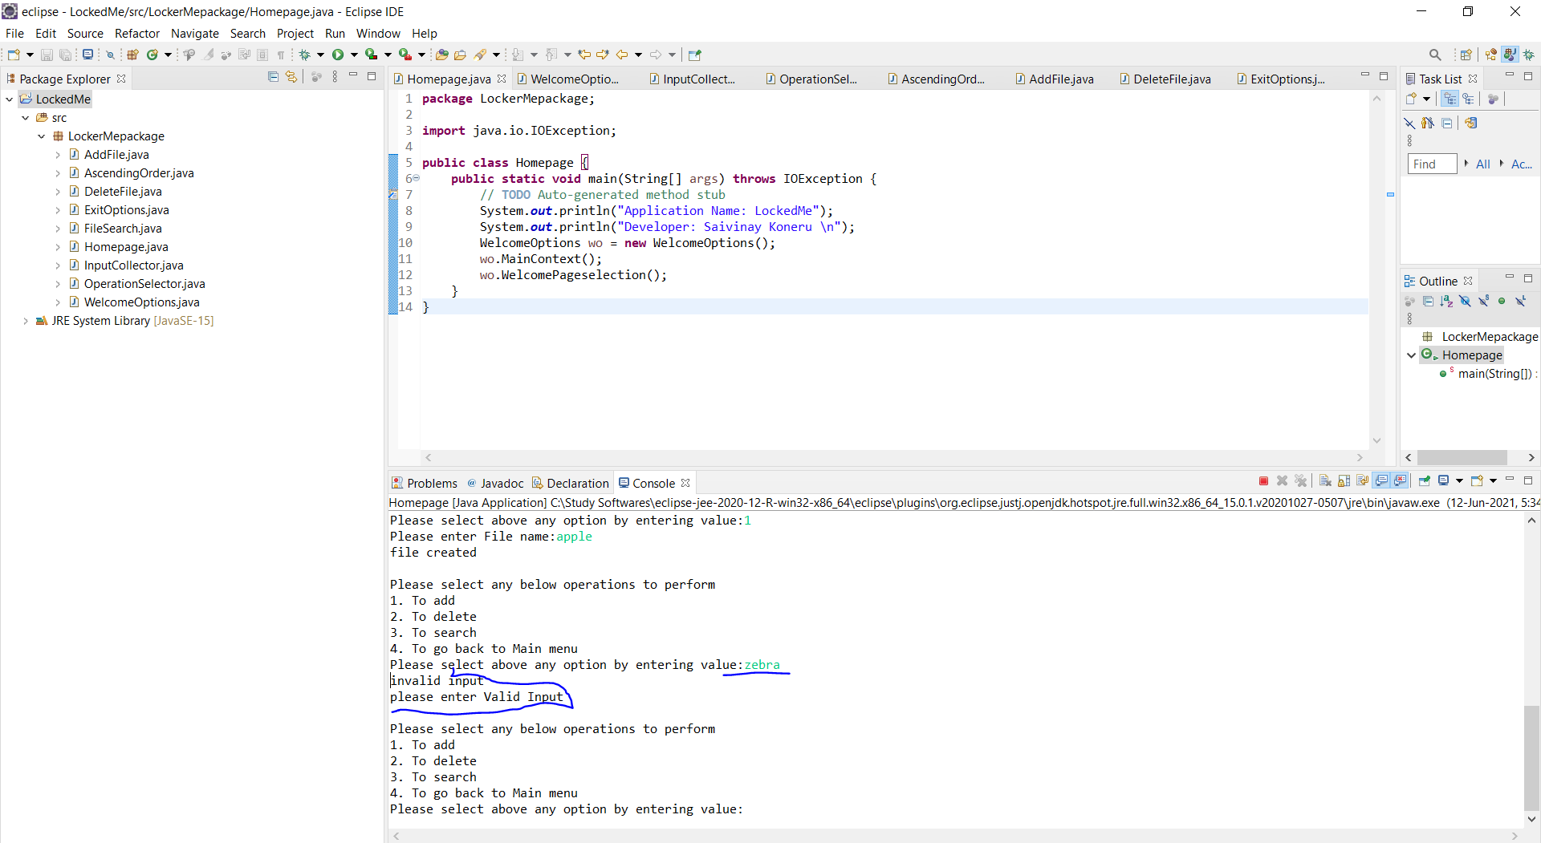
Exceptions handled,In option place trying to enter file name, it showing as invalid input asked to enter again

Slide 7
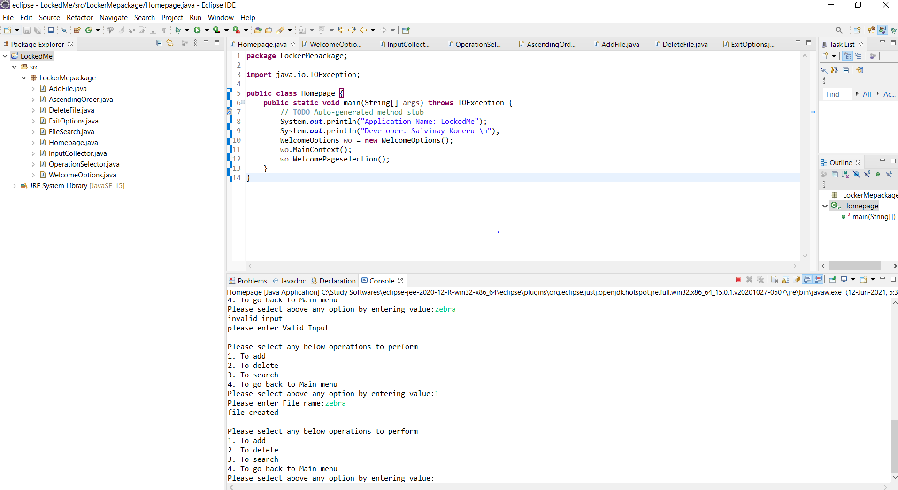
3 more files are created using add option

Slide 8
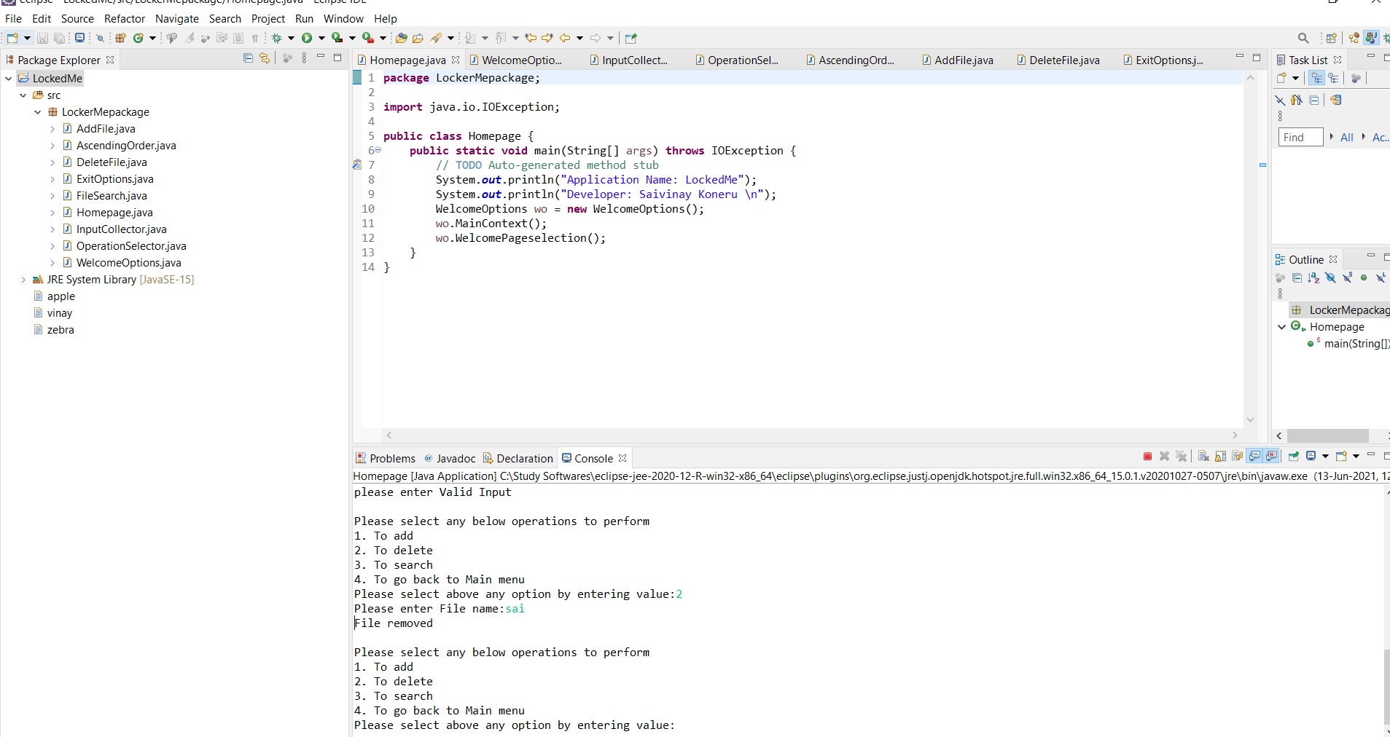
App deleted when we trying to deleted existing file & asking for next operations

Slide 9
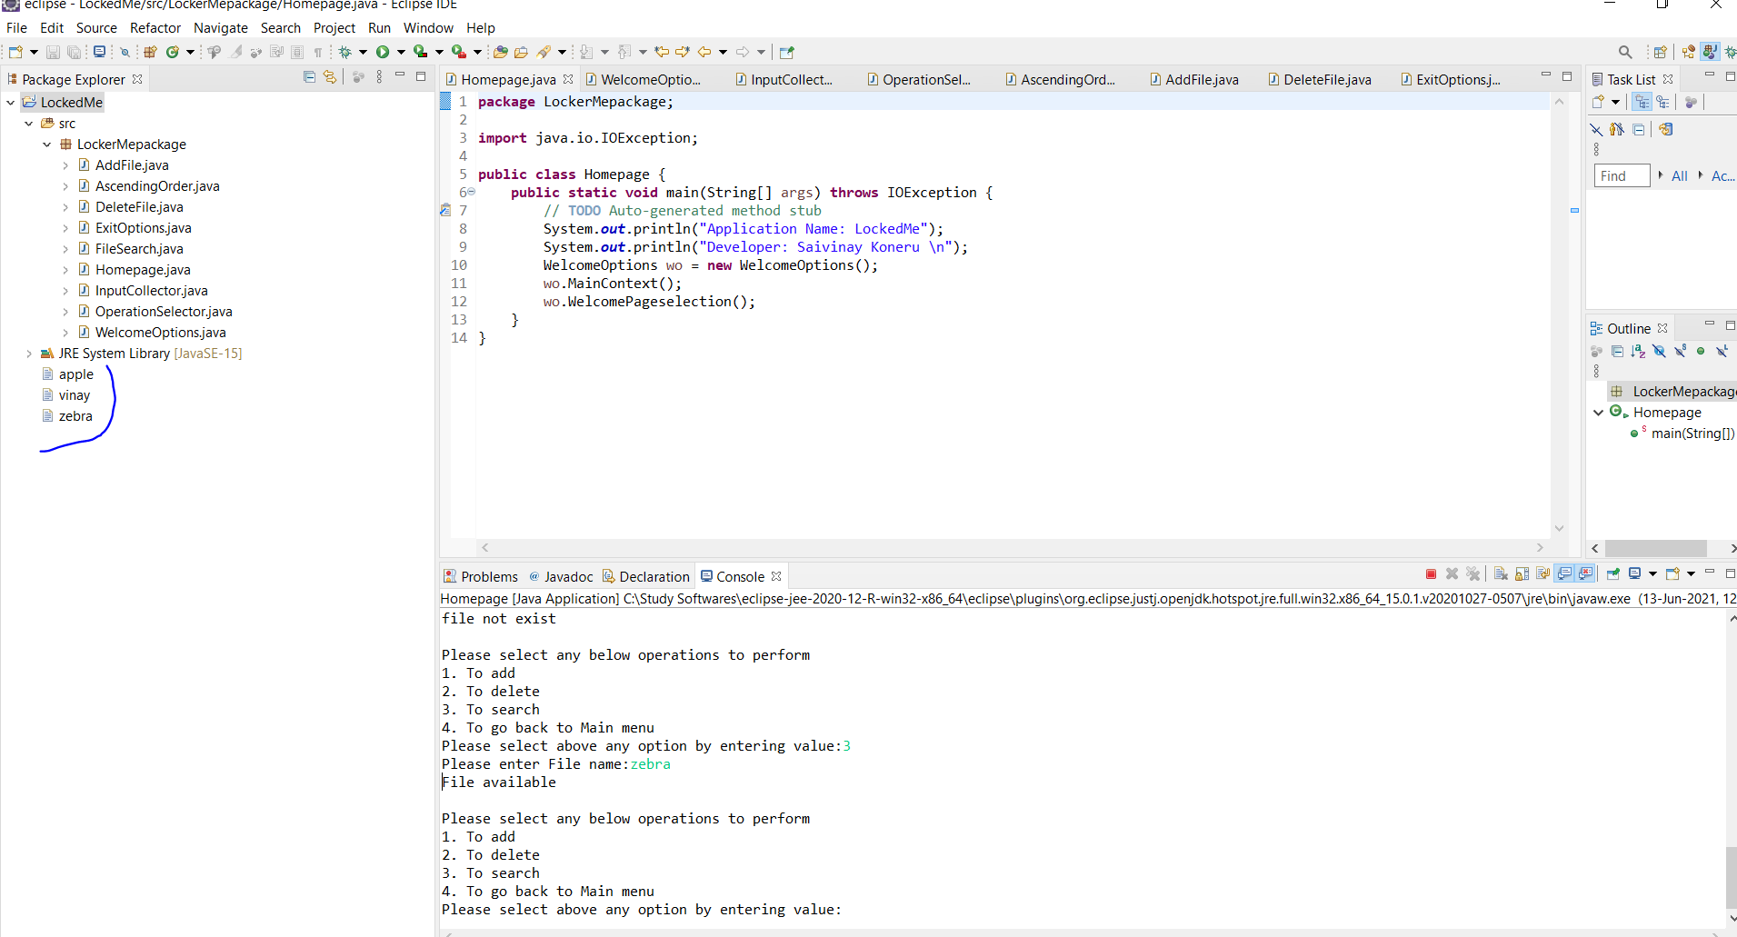
After refresh & while search for already created files showing as available

Slide 10
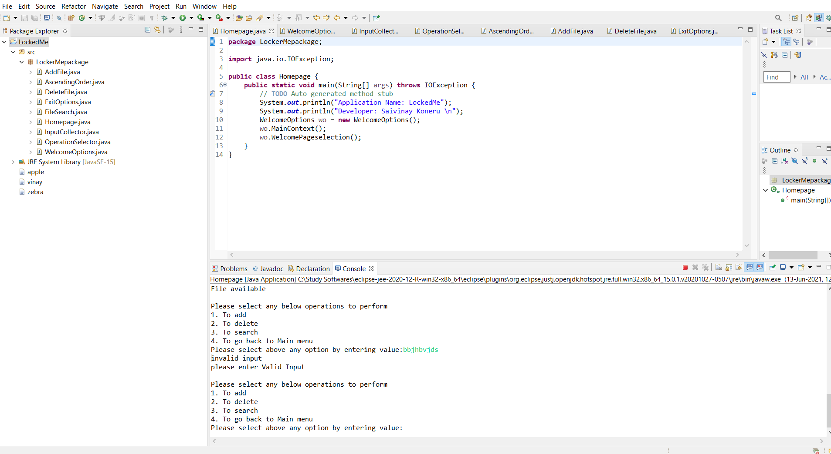
Exception handled, When incorrect & random file search in app showing file not exist

Slide 11
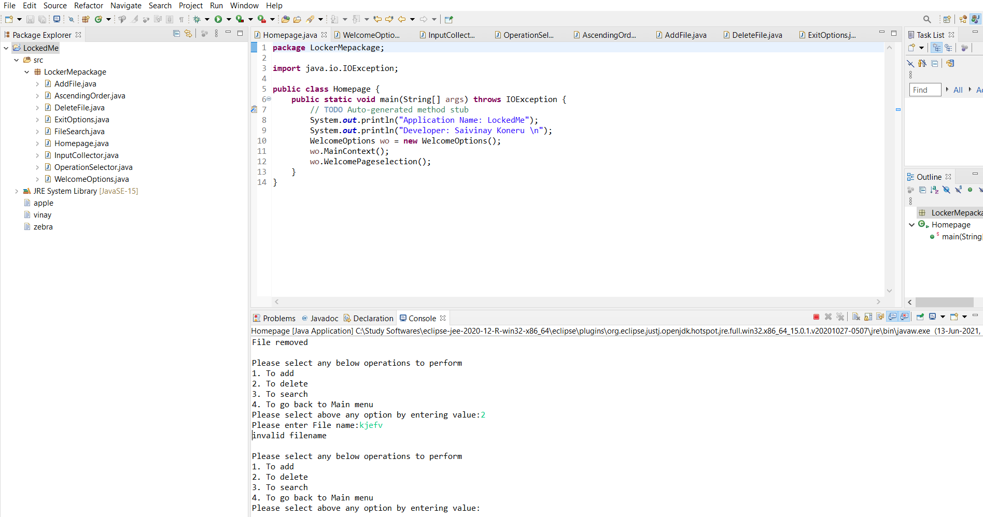
When trying delete random file its showing as as invalid filename

Slide 12
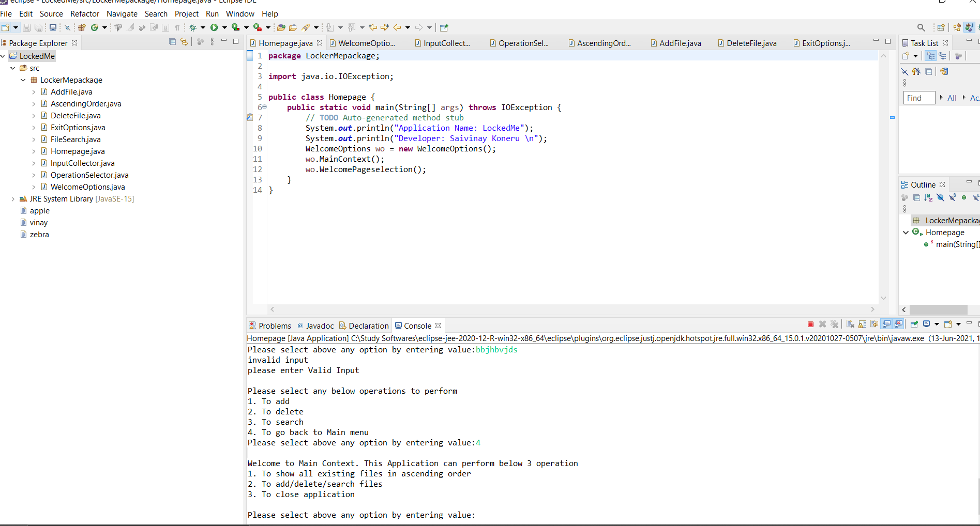
After entering 4 app took to main menu

Slide 13
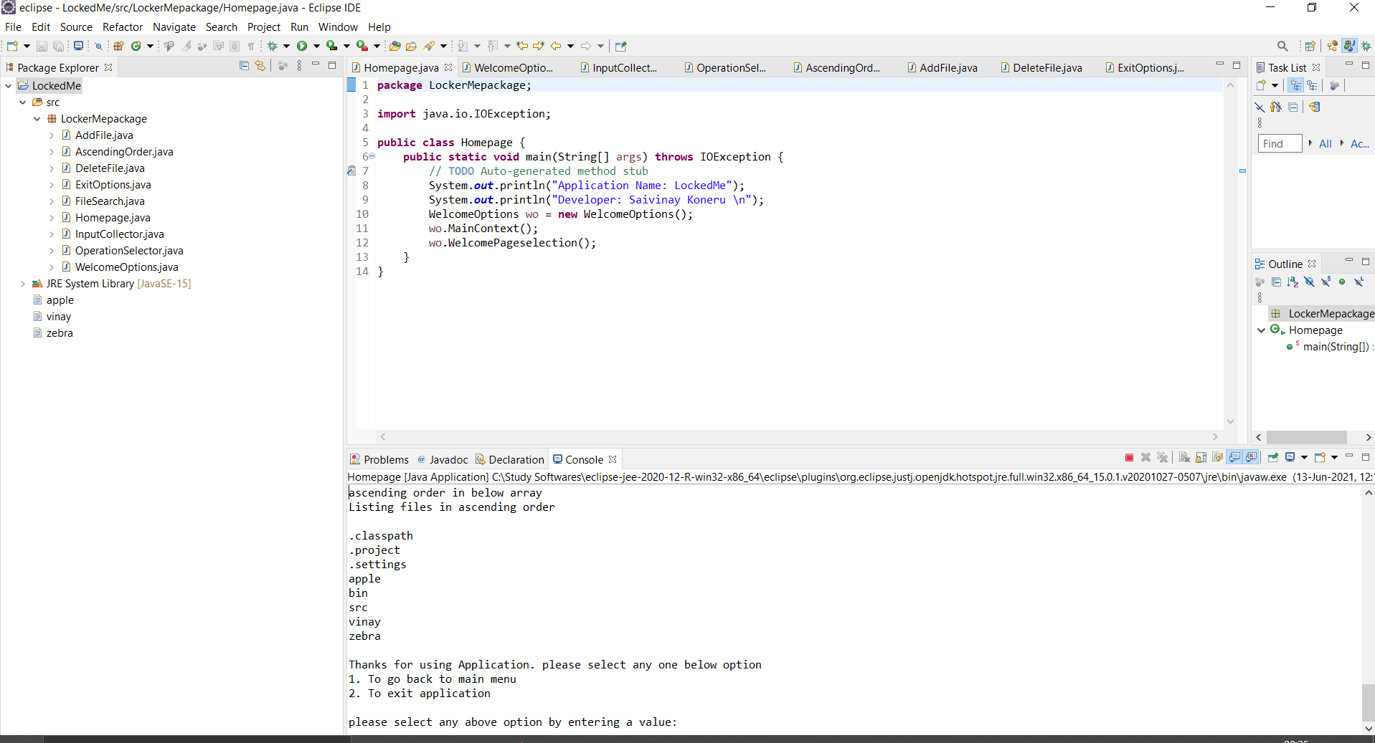
Showed existing file in ascending order with root directory files

Slide 14
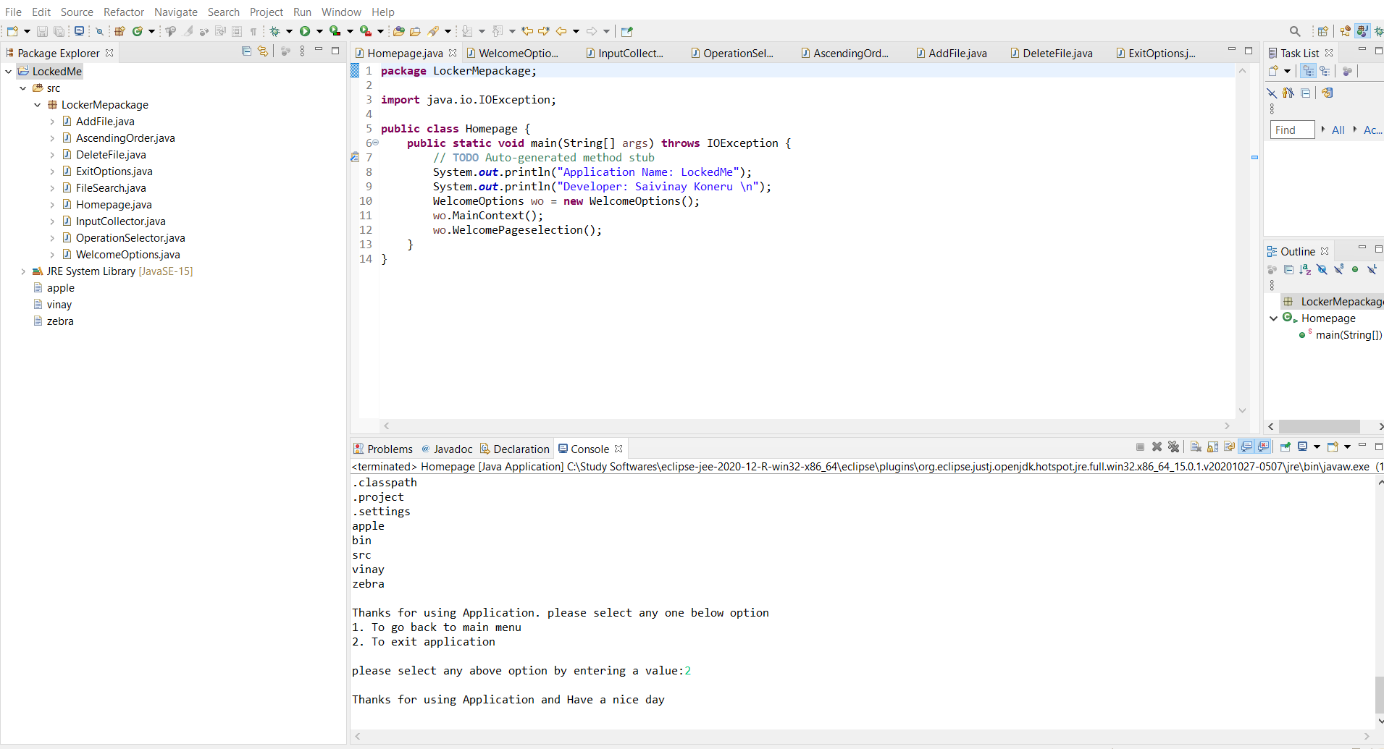
After entering 2 as exit option application ended

